Slide 1
Administrative Services Program Review
Buildings and Grounds Services

Slide 2
Administrative Services Mission Statement
Administrative Services Division is committed to providing an exceptional learning environment by providing the highest quality support services in the most effective and cost efficient manner, with an emphasis on integrity, customer service and continuous improvement.

Slide 3
Buildings & Grounds Services
What departments are included in the Buildings and Grounds Services
Ground Maintenance Crew
Currently has 4 staff members
College Maintenance
Currently has 4 staff members
Athletic Maintenance
Currently has 2 staff members

Slide 4
Grounds & Maintenance Positions
Position | Status
Athletic Field Assistant | Vacant
Athletic Field Maintenance Worker, Sr. | Filled
Athletic Maintenance Lead | Filled
General Maintenance Worker, Sr. | Vacant
General Maintenance Worker, Sr. | Vacant
General Maintenance Worker, Sr. | Filled
General Maintenance Worker, Sr. | Filled
General Maintenance Worker, Sr. | Vacant
General Maintenance Worker, Sr. | Vacant
General Maintenance Worker, Sr. HVACR | Filled
General Maintenance Worker, Sr. HVACR | Filled
Grounds & Maintenance Supervisor | Vacant
Grounds Maintenance Lead | Filled
Grounds Maintenance Worker | Filled
Grounds Maintenance Worker | Filled
Grounds Maintenance Worker, Sr. | Vacant
Grounds Maintenance Worker, Sr. | Filled

Slide 5
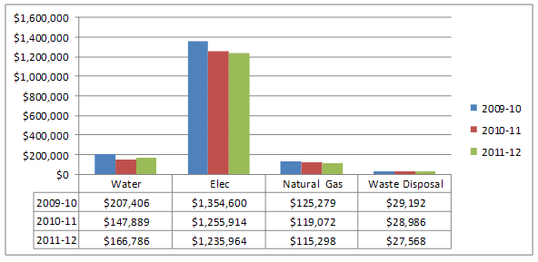
Buildings and Grounds KPI’s

Slide 6
Buildings and Grounds KPI’s
 | 2009-10 | 2010-11 | 2011-12
Maintenance & Operations Expenditures per GSF (less parking structure) | $5.51 | $5.21 | $5.29
Building area maintained per Maintenance Worker by Gross Square Feet (less parking structure) | 84,614.00 | 96,477.83 | 96,477.83
Number of Acres maintained per Grounds Worker | 18.75 | 18.75 | 22.50
 | 2007-08 | 2008-09 | 2009-10 | 2010-11 | 2011-12
Number of Maintenance Workers | 8 | 8 | 6 | 6 | 6
Number of Grounds Workers | 8.2 | 8.2 | 7.2 | 7.2 | 6.0

Slide 7
B&G’s Faculty & Staff Satisfaction Surveys
Satisfaction | Fall 2011
The care and maintenance of the college landscape | 91.2% were satisfied 4.8% were neutral 4% were dissatisfied
Timeliness of classroom repair | 76.6% were satisfied 13.8% were neutral 9.6% were dissatisfied
The quality of renovation and remodel projects performed by the maintenance department | 81% were satisfied 16.1% were neutral 1.7% were dissatisfied

Slide 8
B&G’s Student Satisfaction Surveys
Satisfaction | Fall 2011 | Fall 2010
The maintenance and overall condition of the athletic facilities | 95.4% satisfied | 95.2% were satisfied
The care and maintenance of the college landscape | 96.2% were satisfied | 97.3% were satisfied
The timeliness of classroom repair | 93.8% were satisfied | 91.7% were satisfied
The ability of the new buildings and labs to meet student educational needs | 95.1% were satisfied | 95.5% were satisfied

Slide 9
B&G’s Contributions to Institutional Improvements (outcomes)
Defensible space project, increased fire safety and protection of the educational environment (College Goal 2, 3, 4)
Completion of the CalSense irrigation control system reduced water costs to the college (College Goal 3, 6, 8)
Development of the Landscape Educational Gardens, created additional educational opportunities for students (College Goal 3, 6, 7, 8, 10)

Slide 10
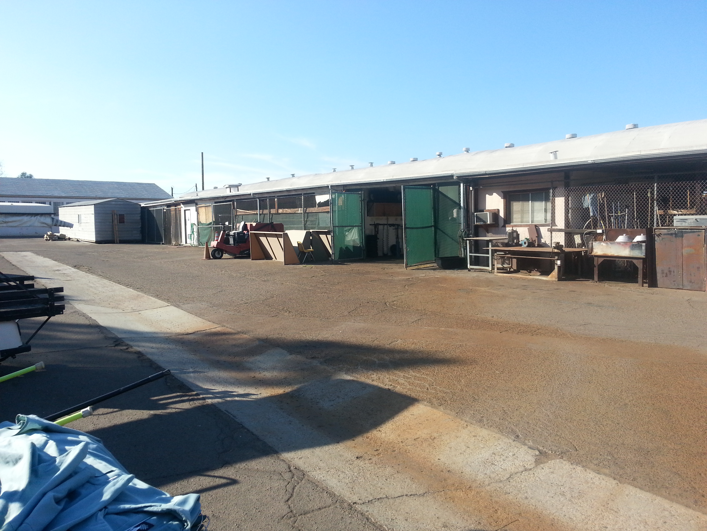
B&G Program Facilities Needs Identified by Program Review
To better support the college and its programs upgraded Building & Grounds maintenance space is needed.
To improve safety and to increase the efficiency and effectiveness of services increased campus storage space is required

Slide 11
B&G Program Equipment Needs Identified by Program Review
To better serve the campus community and ensure a safe environment a person lift is needed to service equipment and lights in the new multi-story buildings
To improve the efficiency of physical and human resources testing and monitoring equipment for the various building systems and cafeteria equipment is needed

Slide 12
B&G Services Goals Based on Program Review Analysis
Identify and incorporate water savings technologies to campus water towers to conserve resources and reduce costs
Update the Grounds and Maintenance websites to include contact information to improve communication
Pursue appropriate staffing levels that will allow for proper maintenance of college facilities and equipment

Slide 13
Administrative Services Program Review
Printing

Slide 14
Printing Positions
Position | Name
Printing Supervisor | Filled
Printing Operations Specialist | Filled
Printing Operations Technician, Sr. | Vacant
Printing Operations Technician, Sr. | Filled
Printing Operations Technician | Filled
Printing Operations Assistant | Filled
Printing Operations Assistant | Vacant

Slide 15
Printing KPI’s

Slide 16
Printing KPI’s

Slide 17
Printing Department KPI’s
 | 2009-10 | 2010-11 | 2011-12
Printing Supply Costs | $103,145 | $119,152 | $90,894
Printing Equipment Rental and Lease Costs | $281,790 | $300,720 | $90,894
Reprint Percentage | Data Not Collected | 0.043% (5 of 11,538) | 0.12% (6 of 4,619)
 | 2007-08 | 2008-09 | 2009-10 | 2010-11 | 2011-12
Number of Printing Employees | 8 | 8 | 6 | 6 | 6

Slide 18
Printing’s Faculty & Staff Satisfaction Surveys
Satisfaction | Fall 2011
Courteousness of staff | 99.1% were satisfied 0.5% were neutral 0.5% were dissatisfied
Timeliness of work processing and completion | 98.6% were satisfied 0.5% were neutral 0.9% were dissatisfied
Quality of documents produced | 98.6% were satisfied 1.4% were neutral 0% were dissatisfied
Knowledge of duplicating processes and formatting | 98.6% were satisfied 1.4% were neutral 0% were dissatisfied

Slide 19
Printing's Contributions to Institutional Improvements (outcomes)
Lowered contract costs and maximized effective use of resources by printing the Student Newspaper, Music Brochures and Class Schedules in-house(College Goal 3, 6, 7, 10 )
Replaced Black and White copy with more environmentally friendly equipment, reducing costs (College Goal 6, 7)
Filled vacant Printing Operations Specialist position providing appropriate leadership and support. (College Goal 3, 11)

Slide 20
Printing’s Needs Identified by Program Review
To improve the efficient use of the printing department resources and lower contract costs, a new digital press is needed to replace the obsolete multi-press.
To support faculty needs throughout the workday the Printing Department needs to fill the vacant Printing Operations Assistant position

Slide 21
Printing’s Goals Based on Program Review Analysis
Enhance and promote online job submission system to reduce paper job submission requests and reduce manual inputting of jobs by the Printing Department staff
Complete cost analysis and investigate purchase of digital press to replace old multi-press 1250.
Complete internal reprint analysis to identify areas for improvement
Provide training to staff on new equipment operation, maintenance, and procedures
Provide appropriate staffing levels based on funding availability

Slide 22
Administrative Services Program Review
Bookstore

Slide 23
Bookstore Positions
Position | Status
Bookstore Manager (B&N’s) | Filled
Bookstore Supervisor | Vacant
Department Lead - Shipping & Receiving | Filled
Bookstore Purchasing Assistant | Filled
Bookstore Purchasing Assistant | Vacant
Bookstore Purchasing Assistant | Vacant
Account Clerk, Sr. | Vacant
Bookseller | Filled
Bookseller | Vacant

Slide 24
Bookstore KPI’s
Began Offering Rentals in FY 2011 |  | Number of Titles | Rental Titles Avail. | Percent of Rental titles Avail.
FY 2011 | GROSSMONT | 2,369 | 337 | 14.3%
FY 2012 | GROSSMONT | 2,519 | 788 | 31.3%
Began Offering E-books in FY 2011 |  | Number of Titles | Titles with E-Book Avail. | Percent of E-Book titles Avail.
FY 2011 | GROSSMONT | 2,369 | 620 | 26.2%
FY 2012 | GROSSMONT | 2,519 | 963 | 38.3%

Slide 25
SALES MIX PERCENTAGE

Slide 26
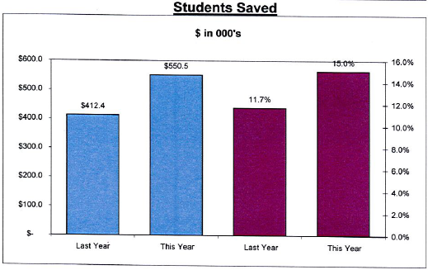
Bookstore’s KPI’s

Slide 27
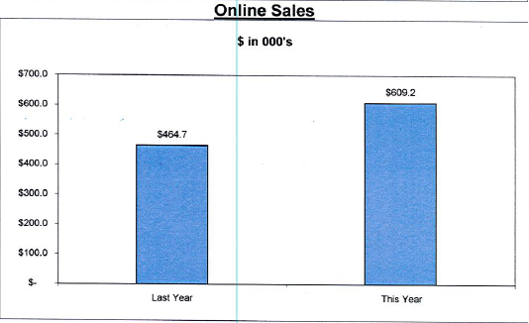
Bookstore’s KPI’s

Slide 28
Bookstore’s Faculty & Staff Satisfaction Surveys
Satisfaction | Fall 2011
Courteousness of staff | 91.6% were satisfied 7.5% were neutral 0.9% were dissatisfied
Staff knowledge of textbook selections | 91.2% were satisfied 7.2% were neutral 1.9% were dissatisfied
Staff knowledge of product information | 90.3% were satisfied 7.9% were neutral 1.6% were dissatisfied
Cleanliness of store | 92.7% were satisfied 7.3% were neutral 0% were dissatisfied

Slide 29
Bookstore’s Student Satisfaction Surveys
Satisfaction | Fall 2011 | Fall 2010
Courteousness of staff | 94.0% satisfied | 93.9% were satisfied
Staff knowledge of textbooks selections | 96.4% were satisfied | 96.2% were satisfied
Staff knowledge of product information | 95.8% were satisfied | 95.7% were satisfied
Cleanliness of store | 98.3% were satisfied | 97.6% were satisfied

Slide 30
Bookstore’s Contributions to Institutional Improvements (outcomes)
Installed 3 additional registers to increase efficiency and shorten the wait times for students(College Goal 2)
Increased textbook rental program and increased the number of sections with rental textbooks available providing lower cost options for students(College Goal 1, 3, 4, 5, 6, )
Cross trained bookstore staff allowing the bookstore to provide efficient service to students and cover staffing shortages (College Goal 3, 6, 11)
Updated point of sales software providing additional functionality and improved processing of student financial aid orders. (College Goal 1, 2, 3, 6)

Slide 31
Bookstore Program Needs Identified by Program Review
To provide more effective, efficient service to the college, the bookstore needs to redesign the sales floor layout and replace rack and display systems.
To provide more effective, efficient service to the college, the bookstore needs to fill the Bookstore Supervisor and Book Purchasing Assistant positions.
To provide more cost effective book choices to students, the bookstore needs to improve the timeliness of faculty textbook adoption

Slide 32
Bookstore’s Goals Based on Program Review Analysis
Explore and implement strategies to reduce instructional materials costs to students
Increase textbook adoption response rate from faculty by 5% from 2012-13 levels.
Pursue appropriate staffing levels that will allow for the provision of efficient and effective service to the college community

Slide 33
Budget Update
Planning & Resource Council
11-15-2012

Slide 34
Impacts of Prop 30 Passing
Increase in FTES by 1,100
Grossmont increase by 763 FTES
Recognize additional Revenue
$5.6 million held in case prop 30 failed
$700,000 FTES Restoration
Budget 4% Deficit as in past years
Approx. $3.4 million
Leaves approx. $2.9 million to flow through formula

Slide 35
FTES Goal Changes

Slide 36
Annual FTES Goal Per Semester

Slide 37
Budget Problems
Communication with public
This did not cure all our problems, we are still on life support
Cash Flow
Large amount deferred until June
Will require continued borrowing
EPA Fund
Requires Prop 30 funds be reported separately and audited. Board to report use in open session
State still finalizing how to report, audit, and decide what constitutes administrative costs

